Slide 1

CSCI 476: Computer Security
Lecture 3: Operating Systems, Processes, and forking()
Reese Pearsall
Fall 2023
*all images are stolen from the internet
https://www.cs.montana.edu/pearsall/classes/fall2023/476/main.html

Slide 2
Announcements
If you have an M1/M2 chip, or if you are still struggling with your VM, check in with me this week
Lab 0 due on Sunday 8/10 @ 11:59 PM
(All assignments will be due on Sundays)
We will start using our VM on Thursday
Might have to cancel a class next week

Slide 3


Slide 4
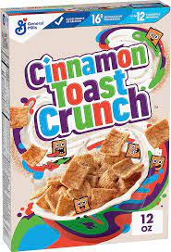
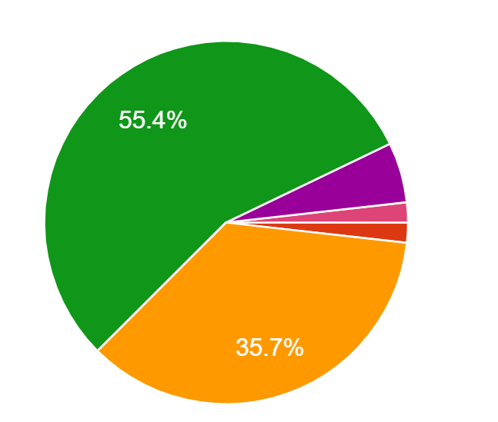
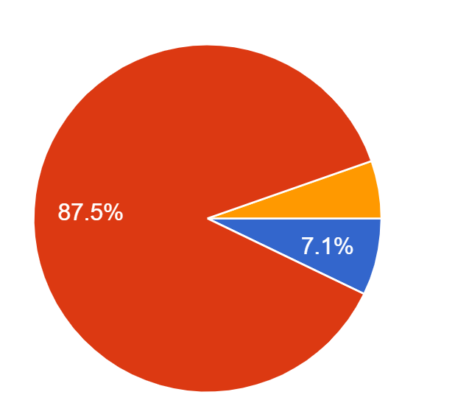
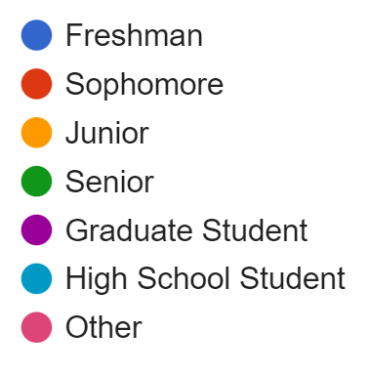

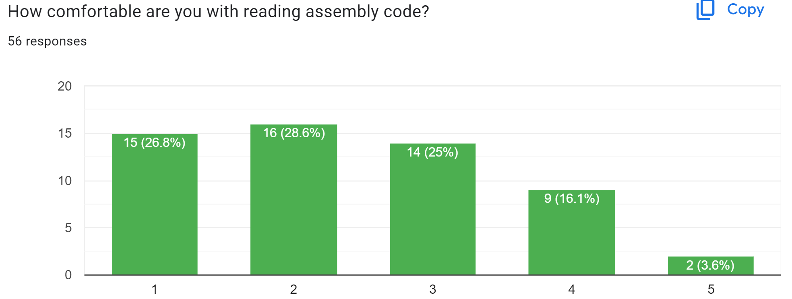
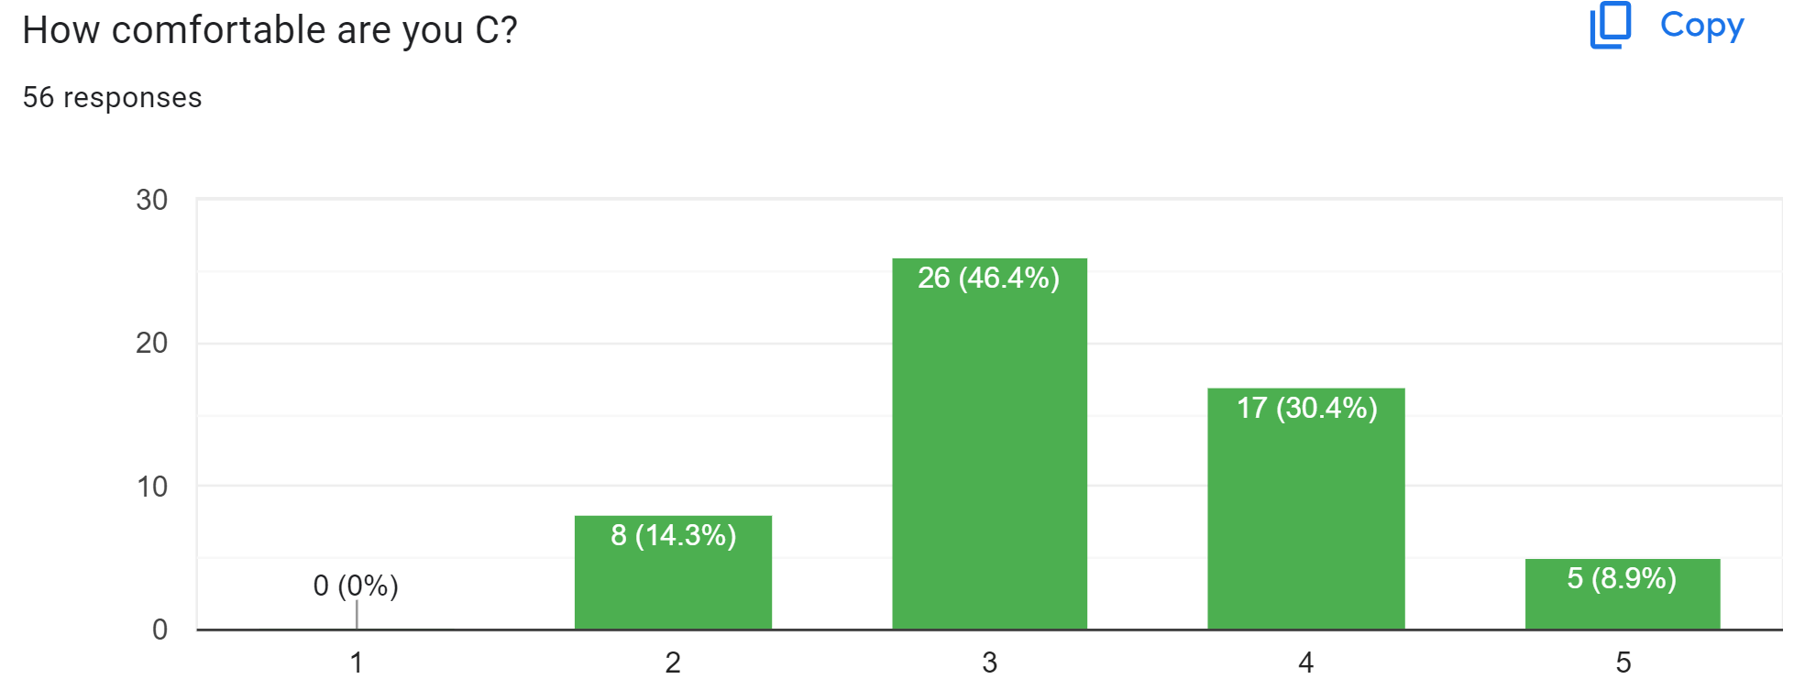
Course Questionnaire Results
Have you taken Operating Systems (CSCI 460)

Slide 5
Course Questionnaire Results
“I am a big procrastinator”

Slide 6
Course Questionnaire Results
“I am a big procrastinator”
“This class seems relevant to my career path”
(and is required)

Slide 7
Course Questionnaire Results
“Im interested in learning about cryptography”
“I am a big procrastinator”
“This class seems relevant to my career path”
(and is required)

Slide 8
Course Questionnaire Results
“Im interested in learning about cryptography”
“I am a big procrastinator”
“This class seems relevant to my career path”
“The best cereal is just milk”
(and is required)

Slide 9

To understand the technical aspects of security, we must have a good understanding of how computers work
operating systems

Slide 10

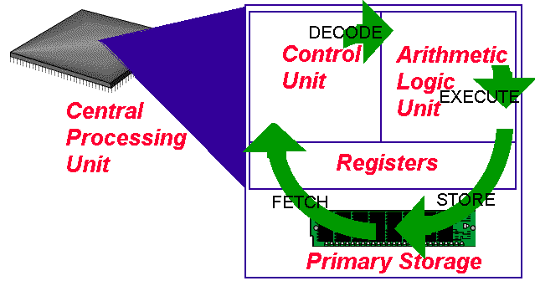
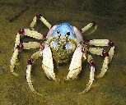
The Operating System
Software
print(“hello world!”)
Operating System
Hardware
CPU
Memory

Slide 11
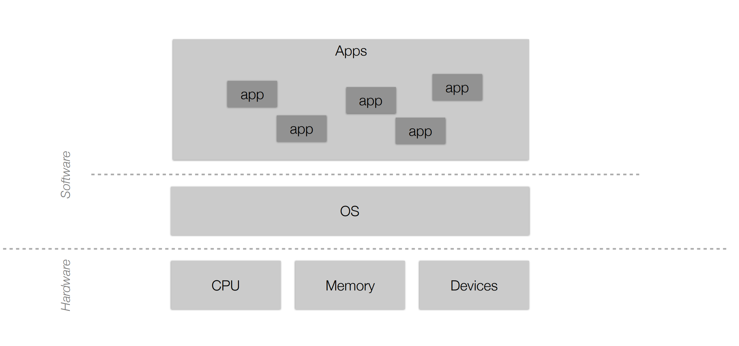
The Operating System
Software
print(“hello world!”)
Operating System
Hardware
CPU
Memory

Slide 12





The jobs of an Operating System
1. Process Manager
2. Interface Manager
3. Memory Manager
4. Traffic Manager
5. Illusion Manager
“The Coach”
“The Bouncer”
“The Farmer”
“The Judge”
“The Illusionist”

Slide 13
The jobs of an Operating System
This will be the focus of the first half of lecture
1. Process Manager
2. Interface Manager
3. Memory Manager
4. Traffic Manager
5. Illusion Manager
“The Coach”
“The Bouncer”
“The Farmer”
“The Judge”
“The Illusionist”

Slide 14
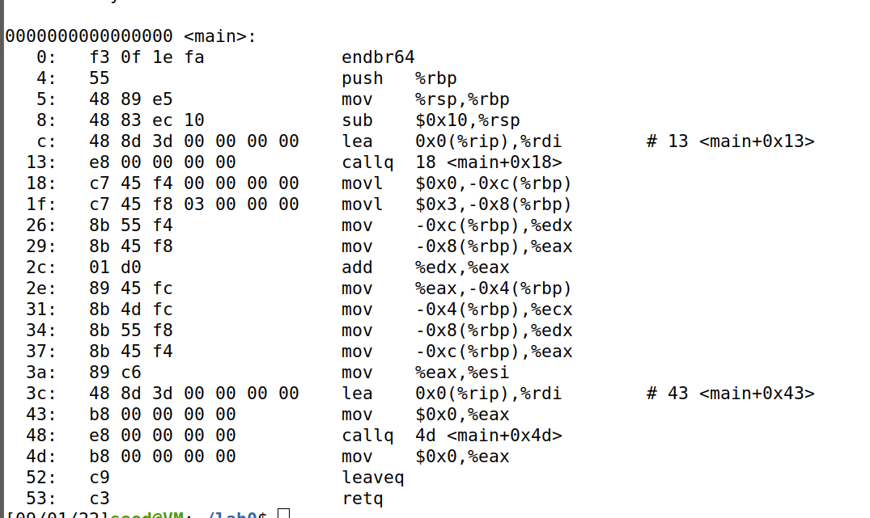
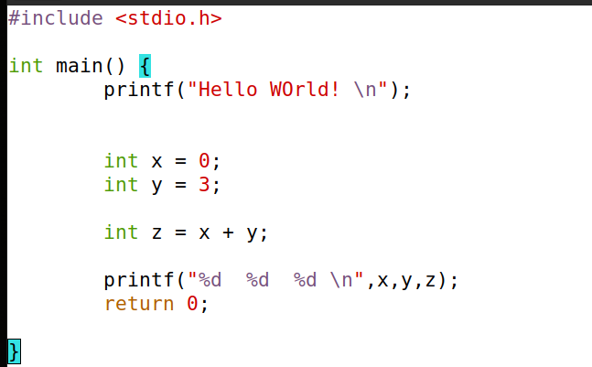

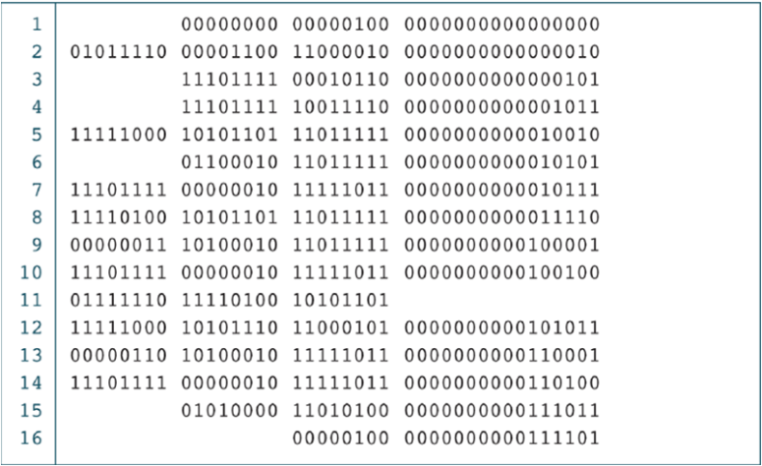

Source code to binary
Preprocessor
Compiler
Assembler
Removal of comments
Expand Macros
Converted to assembly code
.s file
Program A
./hello_world
Linker
Library 1
Library 2
.exe
**THIS PROCESS IS NOT TRUE FOR EVERY LANGUAGE

Slide 15
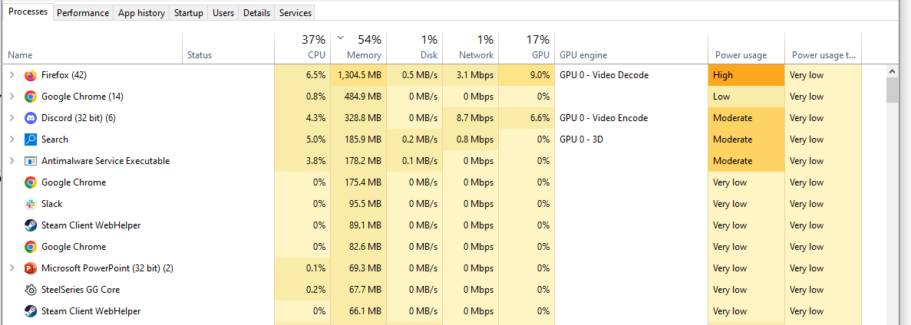
What happens when we run ?
./hello_world
It gets turned into a process
A process is an instance of a running program on a computer

Slide 16
A process is an instance of a running program on a computer
Main Memory
Process A Information
Process A Data
Process A Executable Code
Process B Information
Process B Data
Process B Executable Code
All processes have the following data while they are running:
Executable Code
2. Associated Data
3. Execution Context/Bookkeeping information
(info that the OS needs to handle the process)

Slide 17


Ok, but how do we actually create a process?
• In the Unix family (and others), we use fork() to create a new process
Parent Process
fork()
Parent Process
(such as shell/terminal)
NEW Child Process
fork() duplicates a process so that instead of one process, you get two!

Slide 18
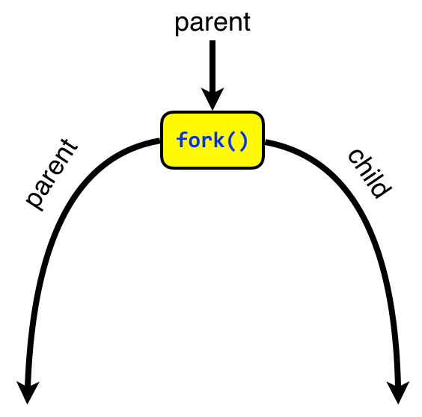
fork() duplicates a process so that instead of one process, you get two!
How can we tell the parent and child apart?
int main(void) {
int pid;
pid = fork();
if (0 == pid) {
// I'm the child
printf("Hi, I'm the child. \n");
}
sleep(1);
printf("I'm the parent.);
return 0;
}
We check the return value of fork()!

Slide 19
fork() duplicates a process so that instead of one process, you get two!
How can we tell the parent and child apart?
int main(void) {
int pid;
pid = fork();
if (0 == pid) {
// I'm the child
printf("Hi, I'm the child. \n");
}
sleep(1);
printf("I'm the parent.);
return 0;
}
We check the return value of fork()!
parent
child
1. Remember, fork()creates two process that are both actively running

Slide 20
fork() duplicates a process so that instead of one process, you get two!
How can we tell the parent and child apart?
int main(void) {
int pid;
pid = fork();
if (0 == pid) {
// I'm the child
printf("Hi, I'm the child. \n");
}
sleep(1);
printf("I'm the parent.);
return 0;
}
We check the return value of fork()!
child
parent
2. fork() always returns 0 for the child process, the parent process jumps to the code after the if statement

Slide 21
fork() duplicates a process so that instead of one process, you get two!
How can we tell the parent and child apart?
int main(void) {
int pid;
pid = fork();
if (0 == pid) {
// I'm the child
printf("Hi, I'm the child. \n");
}
sleep(1);
printf("I'm the parent.);
return 0;
}
We check the return value of fork()!
child
parent
3. fork() always returns 0 for the child process, so the child process will execute the code in the if statement

Slide 22
Demo?
fork1.c

Slide 23
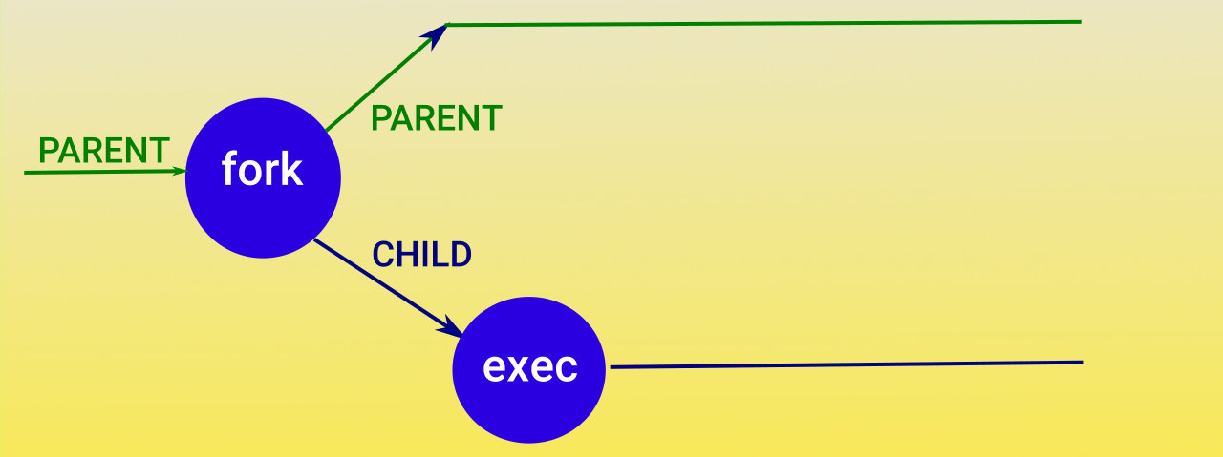
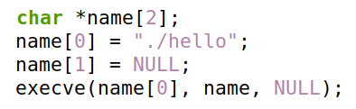
Issue: We want our child process to run an entirely new program (hello_world c program)
We use the exec() family of functions to execute a different program
There are many different forms of the exec() function call

Slide 24
Issue: We want our child process to run an entirely new program (hello_world c program)
We use the exec() family of functions to execute a different program
There are many different forms of the exec() function call
This will invoke a program called hello

Slide 25
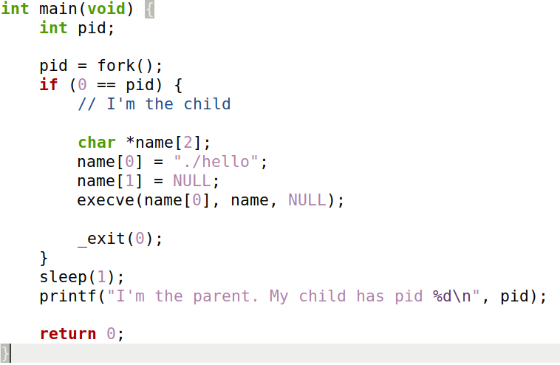
Fork() and Exec()

Slide 26
Fork() and Exec()
Child code
Parent code

Slide 27
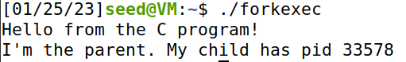
Fork() and Exec()
output

Slide 28
Demo?
forkandexec.c

Slide 29
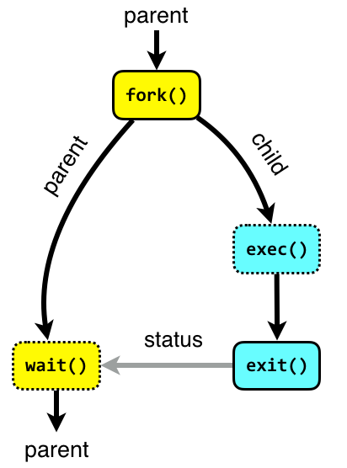
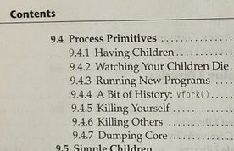
Tl;dr
The programs we run get turned into a process
fork() is used to create a new process
The parent process is typically the shell/terminal, and waits for the child process to finish
The child process runs exec() to run our program
you can kill children with the kill() function
or kill command

Slide 30
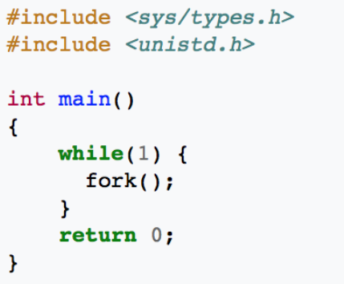
Any ideas what might happen?

Slide 31


“Oh, these forks() aren’t homemade. They were made in factory. A fork() bomb factory. This is a fork() bomb”

Slide 32
A process is an instance of a running program on a computer
Main Memory
Process A Information
Process A Data
Process A Executable Code
Process B Information
Process B Data
Process B Executable Code
All processes have the following data while they are running:
Executable Code
2. Associated Data
3. Execution Context/Bookkeeping information
(info that the OS needs to handle the process)

Slide 33
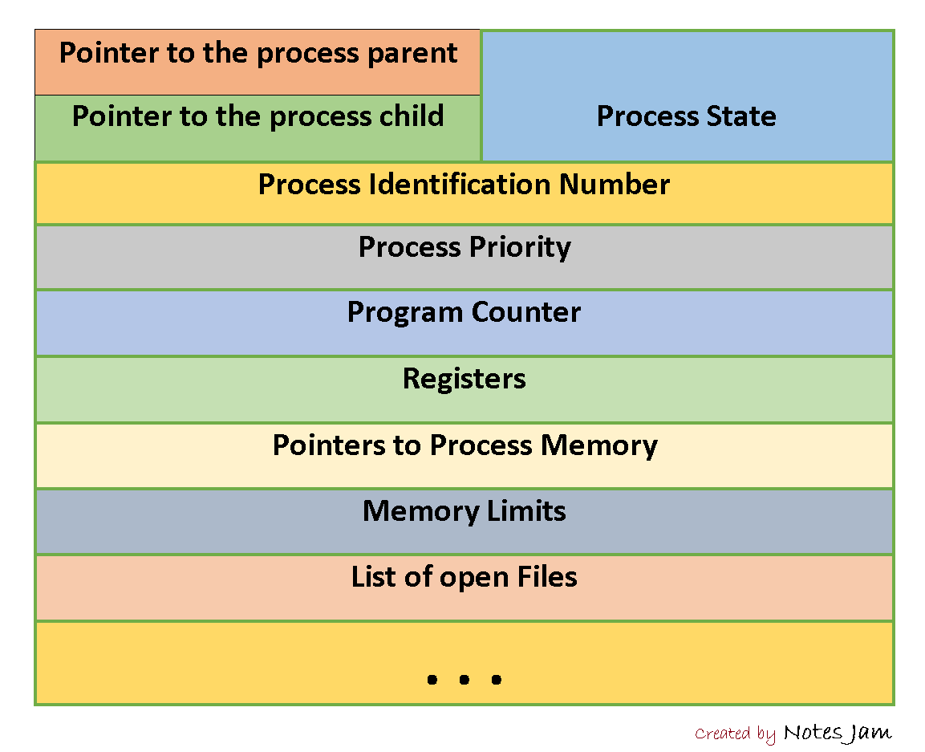
3. Execution Context/Bookkeeping information
Each process has a Process Control Block (PCB)
Example PCB:
Simply just a data structure that holds information
The name of this varies by OS

Slide 34
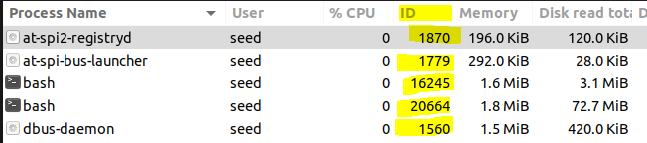

3. Execution Context/Bookkeeping information
Each process has a Process Control Block (PCB)
Example PCB:
Simply just a data structure that holds information
The name of this varies by OS
Every process has a unique process ID (PID)
We can use the PID to search for process, kill process, fork new process, etc

Slide 35
3. Execution Context/Bookkeeping information
Each process has a Process Control Block (PCB)
Example PCB:
Simply just a data structure that holds information
The name of this varies by OS
Each process has a program counter (PC), which tells the CPU the next instruction to run in the process

Slide 36
3. Execution Context/Bookkeeping information
Each process has a Process Control Block (PCB)
Example PCB:
Simply just a data structure that holds information
The name of this varies by OS
PCB also maintains locations for the process Data and Code

Slide 37
3. Execution Context/Bookkeeping information
Each process has a Process Control Block (PCB)
Example PCB:
Simply just a data structure that holds information
The name of this varies by OS

Slide 38

3. Execution Context/Bookkeeping information
Each process has a Process Control Block (PCB)
Example PCB:
Simply just a data structure that holds information
The name of this varies by OS
PCB keeps track of who their parent is, and any child process (good parenting)

Slide 39
3. Execution Context/Bookkeeping information
Each process has a Process Control Block (PCB)
Example PCB:
Simply just a data structure that holds information
The name of this varies by OS
PCB keeps track of who their parent is, and any child process (good parenting)

Slide 40
3. Execution Context/Bookkeeping information
Each process has a Process Control Block (PCB)
Example PCB:
Simply just a data structure that holds information
The name of this varies by OS
A process goes through many states
Active (running)
Blocked
Waiting
Suspended

Slide 41
A process is an instance of a running program on a computer
All processes have the following data while they are running:
Executable Code
2. Associated Data
3. Execution Context/Bookkeeping information
We will talk about what goes here shortly
(info that the OS needs to handle the process)

Slide 42
The jobs of an Operating System
1. Process Manager
“The Coach”
The OS manages many active processes all at once, and they must create processes, manage current process, and control which processes do what
Program is now running as a process
./hello_world
Fork() and exec()

Slide 43
A process is an instance of a running program on a computer
All processes have the following data while they are running:
Executable Code
2. Associated Data
3. Execution Context/Bookkeeping information
(info that the OS needs to handle the process)
Program is now running as a process
./hello_world
Fork() and exec()

Slide 44
Demo time!
int main(void) {
int pid;
pid = fork();
if (0 == pid) {
// I'm the child
printf("Hi, I'm the child. \n");
}
sleep(1);
// we could wait() here
printf("I'm the parent.);
return 0;
}

Slide 45
The jobs of an Operating System
1. Process Manager
2. Interface Manager
3. Memory Manager
4. Traffic Manager
5. Illusion Manager
“The Coach”
“The Bouncer”
“The Farmer”
“The Judge”
“The Illusionist”

Slide 46
Operating Systems Review

Slide 47


Operating Systems Review
Responsibilities of the OS?
Interface Manager
Manages communication between apps and hardware

Slide 48

Operating Systems Review
Responsibilities of the OS?
Interface Manager
Manages communication between apps and hardware
Process Manager
Manages how processes are structured and how to handle many processes running at once

Slide 49

Operating Systems Review
Responsibilities of the OS?
Interface Manager
Manages communication between apps and hardware
Process Manager
Manages how processes are structured and how to handle many processes running at once
Traffic Manager
Manages which programs should be executed by the CPU

Slide 50
Operating Systems Review
Responsibilities of the OS?
Interface Manager
Manages communication between apps and hardware
Process Manager
Manages how processes are structured and how to handle many processes running at once
Traffic Manager
Manages which programs should be executed by the CPU
Memory Manager
Manages how physical memory is utilized

Slide 51

Operating Systems Review
Responsibilities of the OS?
Interface Manager
Manages communication between apps and hardware
Process Manager
Manages how processes are structured and how to handle many processes running at once
Traffic Manager
Manages which programs should be executed by the CPU
Memory Manager
Manages how physical memory is utilized

Slide 52




Operating Systems Review
Responsibilities of the OS?
Interface Manager
Manages communication between apps and hardware
How does an application get access to a computer's resources?

Slide 53
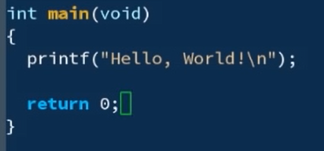
Syscalls
Applications evoke operating system defined functions, or system calls (syscalls), to access computing resources

Slide 54
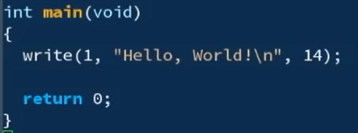
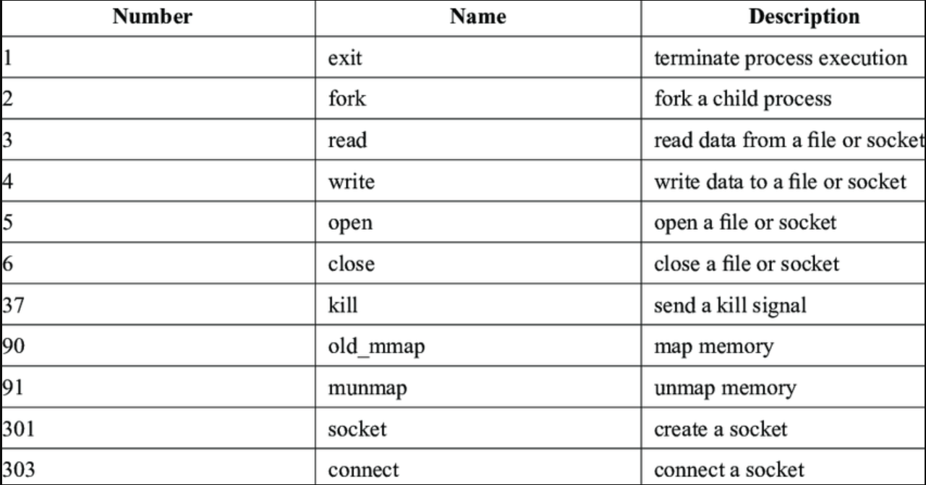
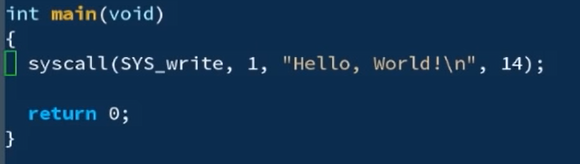
Syscalls
Applications evoke operating system defined functions, or system calls (syscalls), to access computing resources

Slide 55
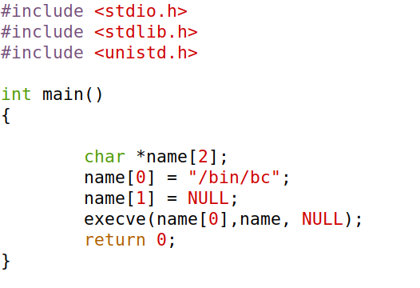
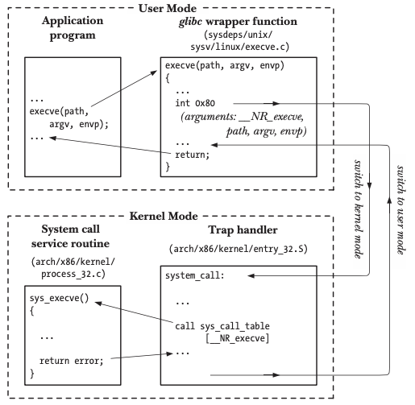
Syscalls
Applications evoke operating system defined functions, or system calls (syscalls), to access computing resources
syscall

Slide 56
Syscalls
Applications evoke operating system defined functions, or system calls (syscalls), to access computing resources
Libraries handle the system calls for us
syscall

Slide 57
Syscalls
Applications evoke operating system defined functions, or system calls (syscalls), to access computing resources
Libraries handle the system calls for us
syscall
The operating system have hundreds of different syscalls, and different syscalls have different parameters, we need a way to distinguish them
EAX
EBX
ECX
EDX

Slide 58
Syscalls
Applications evoke operating system defined functions, or system calls (syscalls), to access computing resources
Libraries handle the system calls for us
syscall
The operating system have hundreds of different syscalls, and different syscalls have different parameters, we need a way to distinguish them
EAX
System Call Number
EBX
Address of “/bin/bc”
ECX
0 or 1
Environment variables
The OS will look at the values at certain registers!
EDX
INT 0x80
send trap to kernel and invoke the syscall

Slide 59
Syscalls
Applications evoke operating system defined functions, or system calls (syscalls), to access computing resources
Libraries handle the system calls for us
syscall
EAX
System Call Number
EBX
Address of “/bin/bc”
ECX
0 or 1
Environment variables
EDX
INT 0x80
send trap to kernel and invoke the syscall

Slide 60
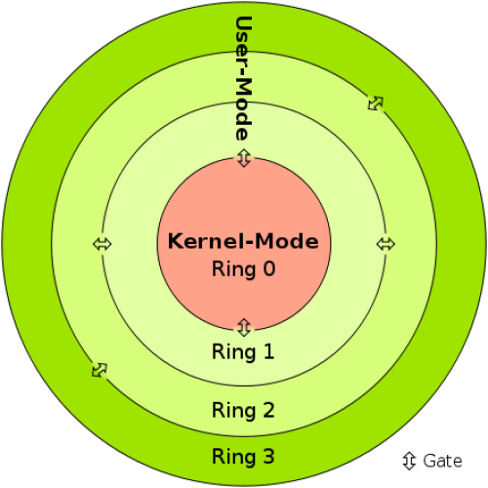
Syscalls
All applications run in user mode.
The code has no ability to directly access hardware
Code running in user mode must use API/syscalls to access hardware and memory

Slide 61
Syscalls
All applications run in user mode.
The code has no ability to directly access hardware
Code running in user mode must use API/syscalls to access hardware and memory
Code running in kernel-mode has complete, unrestricted access to computer resources
Reserved for the lowest-level trusted functions of the operating system

Slide 62
Syscalls
The collective functionality and services of the OS that manages the computer and its resources is called the kernel

Slide 63
Syscalls
Applications evoke operating system defined functions, or system calls (syscalls), to access computing resources
Libraries handle the system calls for us
syscall
EAX
System Call Number
EBX
Address of “/bin/bc”
ECX
0 or 1
Environment variables
EDX
INT 0x80
send trap to kernel and invoke the syscall

Slide 64

Syscalls
Applications evoke operating system defined functions, or system calls (syscalls), to access computing resources
Libraries handle the system calls for us
syscall
EAX
System Call Number
EBX
Address of “/bin/bc”
ECX
0 or 1
Environment variables
EDX
INT 0x80
send trap to kernel and invoke the syscall

Slide 65
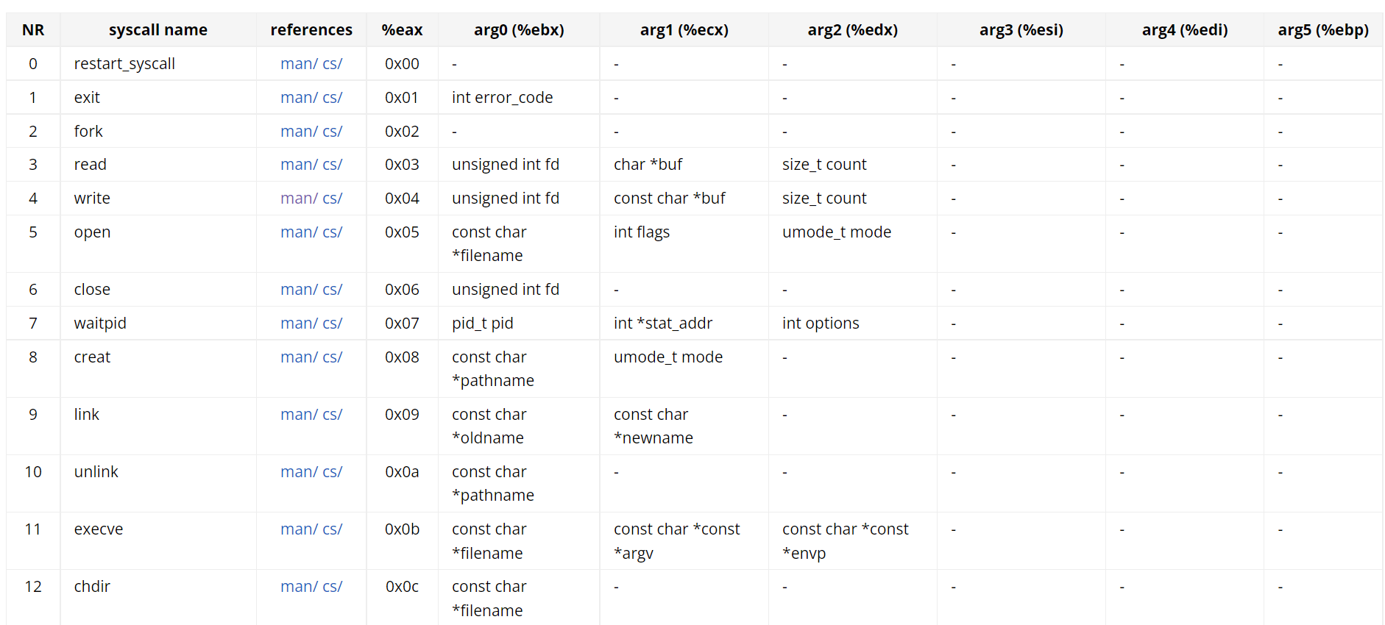
Syscalls
Applications evoke operating system defined functions, or system calls (syscalls), to access computing resources
Libraries handle the system calls for us
syscall
EAX
System Call Number
EBX
Address of “/bin/bc”
ECX
0 or 1
Environment variables
EDX
INT 0x80
send trap to kernel and invoke the syscall

Slide 66
Syscalls
Applications evoke operating system defined functions, or system calls (syscalls), to access computing resources
Libraries handle the system calls for us
https://chromium.googlesource.com/chromiumos/docs/+/master/constants/syscalls.md#x86-32_bit
syscall
EAX
System Call Number
EBX
Address of “/bin/bc”
ECX
0 or 1
Environment variables
EDX
INT 0x80
send trap to kernel and invoke the syscall

Slide 67
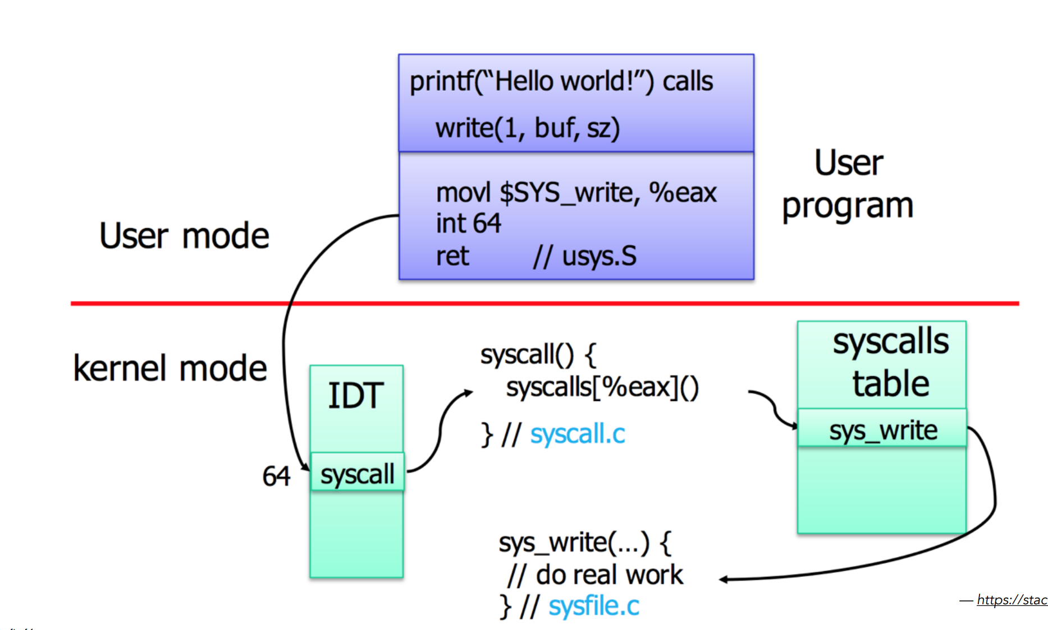
Syscalls

Slide 68





Applications Layout in Memory
Process Manager
Manages how processes are structured and how to handle many processes running at once
How does a program get loaded into memory?

Slide 69

Applications Layout in Memory
Process Manager
Manages how processes are structured and how to handle many processes running at once
How does a program get loaded into memory?
An active program running on a computer is called a process

Slide 70

Applications Layout in Memory
Process Manager
Manages how processes are structured and how to handle many processes running at once
What does this look like?
Executable Code
2. Associated Data
3. Execution Context/Bookkeeping information

Slide 71

Applications Layout in Memory
Process Manager
Manages how processes are structured and how to handle many processes running at once
What does a program look like in memory?

Slide 72
Applications Layout in Memory
Process Manager
Manages how processes are structured and how to handle many processes running at once
0xFFFFFFFFFFFFFFFFFFFFFFFFF
Text
Executable instructions
Text Segment- binary executable instructions for the process
What does a program look like in memory?
0x00000000000000000000000

Slide 73
Applications Layout in Memory
Process Manager
Manages how processes are structured and how to handle many processes running at once
0xFFFFFFFFFFFFFFFFFFFFFFFFF
Data
Static variables with values
Text
Executable instructions
Data Segment- Static variables initialized by the programmer
What does a program look like in memory?
0x00000000000000000000000

Slide 74
Applications Layout in Memory
Process Manager
Manages how processes are structured and how to handle many processes running at once
0xFFFFFFFFFFFFFFFFFFFFFFFFF
BSS
Static variables without a value
Data
Static variables with values
Text
Executable instructions
BSS Segment- contains statically allocated variables that are declared, but have not been assigned a value yet
What does a program look like in memory?
0x00000000000000000000000

Slide 75
Applications Layout in Memory
Process Manager
Manages how processes are structured and how to handle many processes running at once
0xFFFFFFFFFFFFFFFFFFFFFFFFF
Heap
Space for dynamically allocated memory
BSS
Static variables without a value
Data
Static variables with values
Text
Executable instructions
Heap- memory set aside for dynamic allocation (e.g. malloc). Grows “up” as more memory is allocated
What does a program look like in memory?
0x00000000000000000000000

Slide 76
Applications Layout in Memory
Process Manager
Manages how processes are structured and how to handle many processes running at once
0xFFFFFFFFFFFFFFFFFFFFFFFFF
Stack
Space for function variables (temporary)
Heap
Space for dynamically allocated memory
BSS
Static variables without a value
Data
Static variables with values
Text
Executable instructions
Stack – memory for storing function variables. Grows “down” as additional functions are called
What does a program look like in memory?
0x00000000000000000000000

Slide 77





Applications Layout in Memory
Process Manager
Manages how processes are structured and how to handle many processes running at once
0xFFFFFFFFFFFFFFFFFFFFFFFFF
OS Kernel Space
Stack
Space for function variables (temporary)
Heap
Space for dynamically allocated memory
BSS
Static variables without a value
Data
Static variables with values
Text
Executable instructions
Executable Code
2. Associated Data
3. Execution Context/Bookkeeping information
0x00000000000000000000000

Slide 78
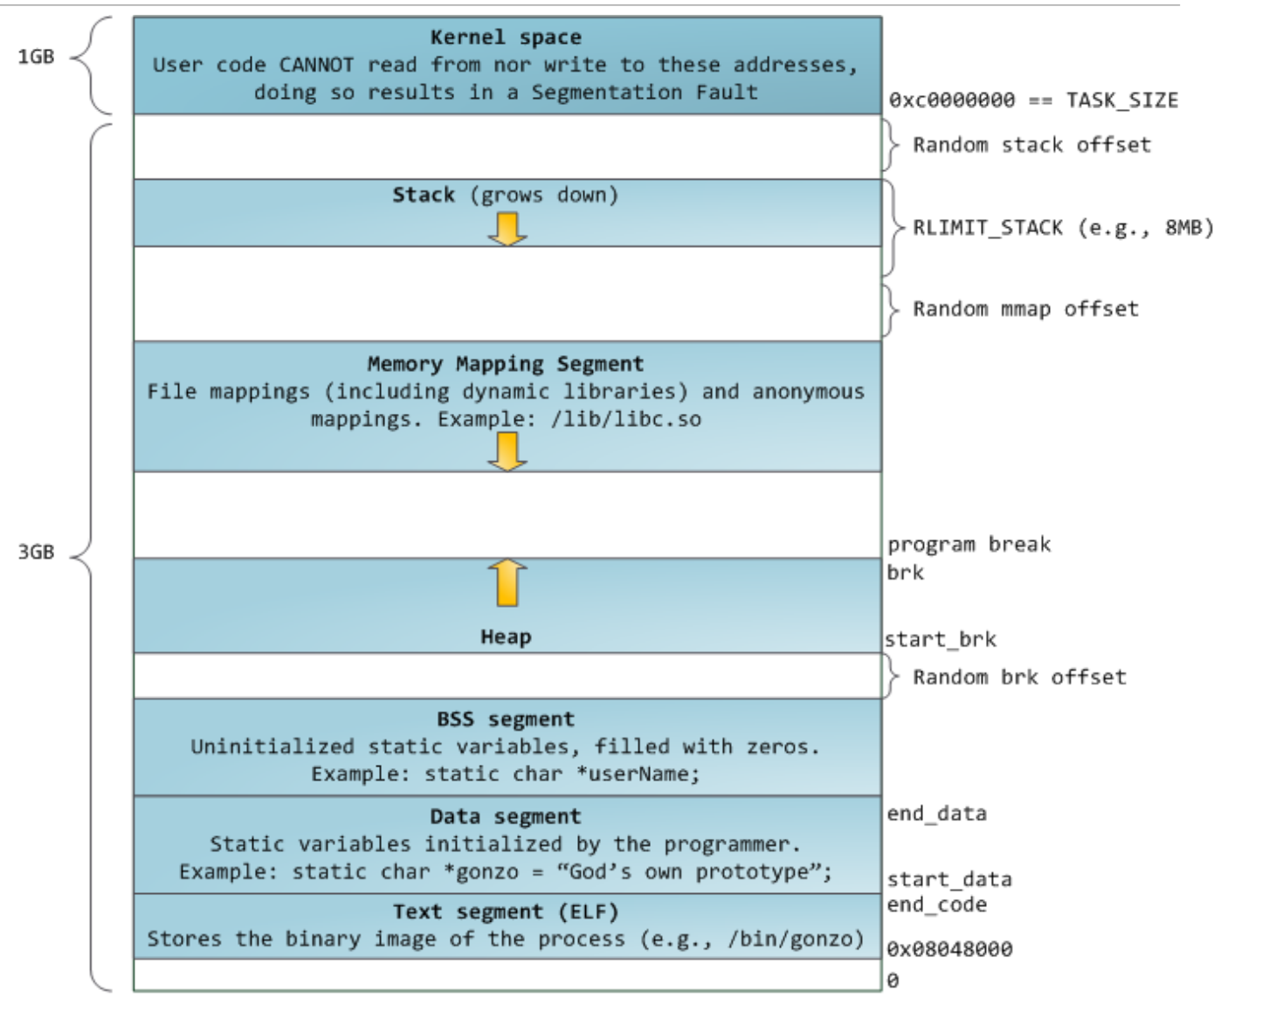
Applications Layout in Memory
Demo?

Slide 79
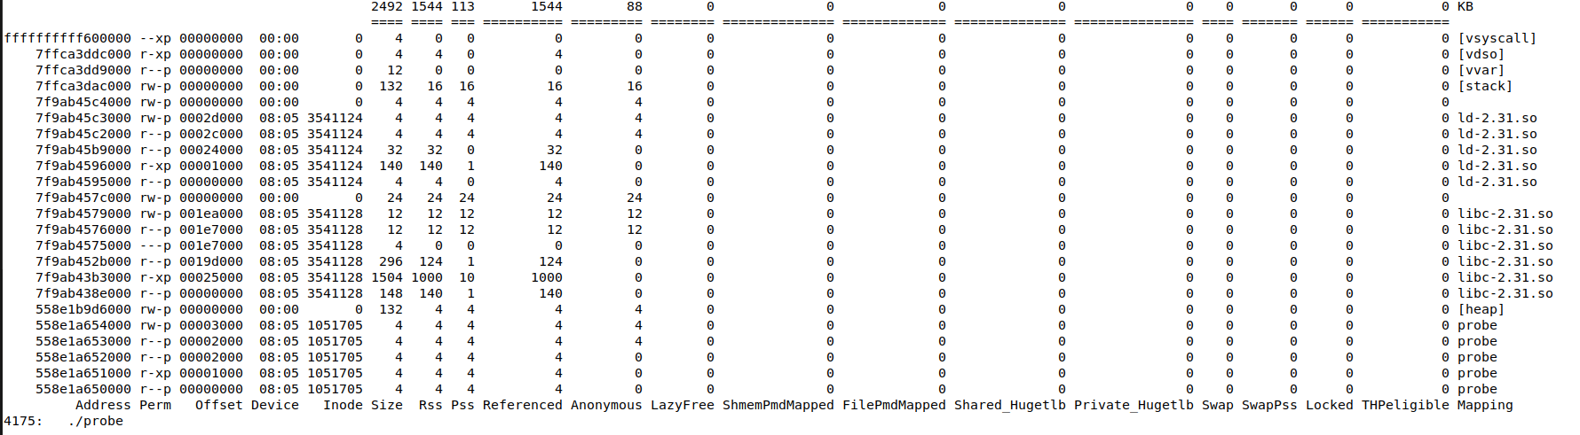
Applications Layout in Memory
Ouput of pmap (process mapping tool)

Slide 80
Applications Layout in Memory
Ouput of pmap (process mapping tool)
“probe” is the name of our executable

Slide 81
Applications Layout in Memory
Ouput of pmap (process mapping tool)
BSS
Static variables without a value
Data
Static variables with values
“probe” is the name of out executable
This section is executable “x”
Text
Executable instructions

Slide 82
Applications Layout in Memory
Ouput of pmap (process mapping tool)
Heap
Space for dynamically allocated memory
Beginning of heap
BSS
Static variables without a value
Data
Static variables with values
“probe” is the name of out executable
This section is executable “x”
Text
Executable instructions

Slide 83
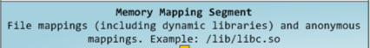
Applications Layout in Memory
Ouput of pmap (process mapping tool)
Heap
Space for dynamically allocated memory
Beginning of heap
BSS
Static variables without a value
Data
Static variables with values
“probe” is the name of out executable
This section is executable “x”
Text
Executable instructions

Slide 84
Applications Layout in Memory
Ouput of pmap (process mapping tool)
Stack
Space for function variables (temporary)
Beginning of stack
Heap
Space for dynamically allocated memory
Beginning of heap
BSS
Static variables without a value
Data
Static variables with values
“probe” is the name of out executable
This section is executable “x”
Text
Executable instructions

Slide 85
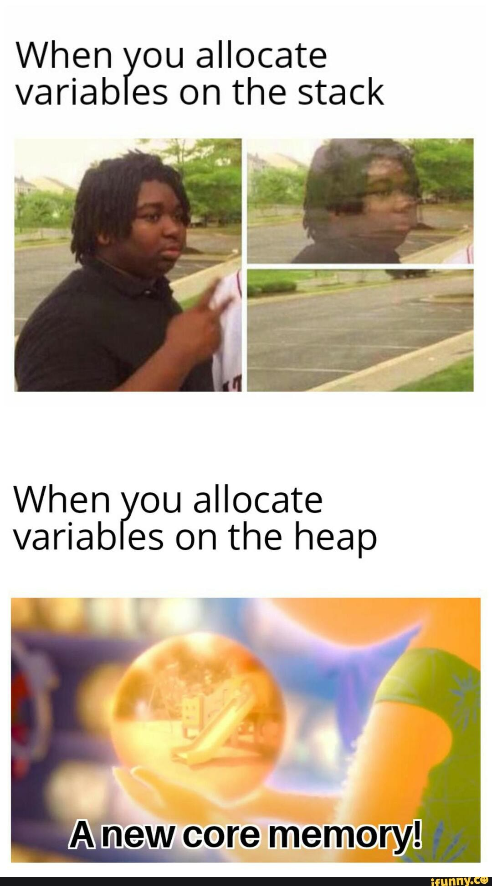
Applications Layout in Memory
Ouput of pmap (process mapping tool)
Stack
Space for function variables (temporary)
Beginning of stack
Heap
Space for dynamically allocated memory
Beginning of heap
BSS
Static variables without a value
Data
Static variables with values
“probe” is the name of out executable
This section is executable “x”
Text
Executable instructions

Slide 86
Applications Layout in Memory
Ouput of pmap (process mapping tool)
OS Kernel Space
Stack
Space for function variables (temporary)
Beginning of stack
Heap
Space for dynamically allocated memory
Beginning of heap
BSS
Static variables without a value
Data
Static variables with values
“probe” is the name of out executable
This section is executable “x”
Text
Executable instructions

Slide 87
Applications Layout in Memory
Ouput of pmap (process mapping tool)
OS Kernel Space
Stack
Space for function variables (temporary)
Heap
Space for dynamically allocated memory
BSS
Static variables without a value
Data
Static variables with values
Text
Executable instructions

Slide 88
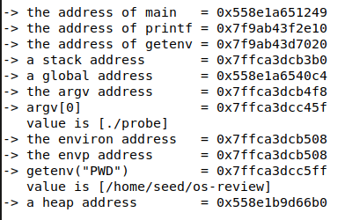
Applications Layout in Memory
Ouput of pmap (process mapping tool)

Slide 89
Applications Layout in Memory
Ouput of pmap (process mapping tool)
Where is “main” located in memory?

Slide 90


Applications Layout in Memory
Ouput of pmap (process mapping tool)
Where is “main” located in memory?
main is code in our program, so it goes inside the text segment

Slide 91
Applications Layout in Memory
Ouput of pmap (process mapping tool)
Where is “printf” located in memory?

Slide 92


Applications Layout in Memory
Ouput of pmap (process mapping tool)
Where is “printf” located in memory?
printf is executable code from a shared library (libc) so we are in the memory mapping segment!

Slide 93
Applications Layout in Memory
Ouput of pmap (process mapping tool)
Where is “argv” located in memory?
argv is an array that holds the command line parameters passed into this program

Slide 94


Applications Layout in Memory
Ouput of pmap (process mapping tool)
Where is “argv” located in memory?
argv is the argument to the main function, so we are in the stack!

Slide 95
Applications Layout in Memory
Process C
Process B
Process X
Process A
We have many programs that are actively running on our computer

Slide 96
Applications Layout in Memory
8GB
20GB
Process C
Process B
Process X
Process A
We have many programs that are actively running on our computer
Process P
What if we have a program that is bigger than out entire main memory?

Slide 97
Applications Layout in Memory
8GB
20GB
Process C
Process B
Process X
Process A
We have many programs that are actively running on our computer
Process P
What if we have a program that is bigger than out entire main memory?
Does our computer crash?

Slide 98

Memory management
8GB
Process C
Process B
Process X
Process A
Virtual Memory uses secondary storage to give programs the illusion that they have infinite storage
Secondary Storage

Slide 99
Memory management
8GB
Process C
Process B
Process X
Process A
Virtual Memory uses secondary storage to give programs the illusion that they have infinite storage
Secondary Storage
We split the process into smaller pages. Load pages into memory only when needed
Process P
Process X

Slide 100
Memory management
8GB
Process C
Process P
Process B
Process X
Process A
Virtual Memory uses secondary storage to give programs the illusion that they have infinite storage
Secondary Storage
We split the process into smaller pages. Load pages into memory only when needed
Process P
Process X

Slide 101
Memory management
8GB
Process C
Process P
Process B
Process X
Process A
Process P
Virtual Memory uses secondary storage to give programs the illusion that they have infinite storage
Secondary Storage
We split the process into smaller, fixed-size, pages. Load pages into memory only when needed
Process P
Process X

Slide 102
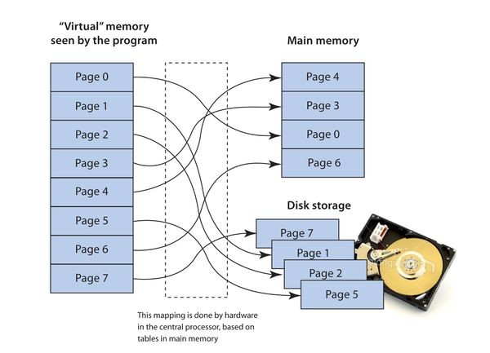
Memory management
Virtual Memory uses secondary storage to give programs the illusion that they have infinite storage
We split the process into smaller, fixed-size, pages. Load pages into memory only when needed
Constantly swapping stuff in and out of main memory

Slide 103
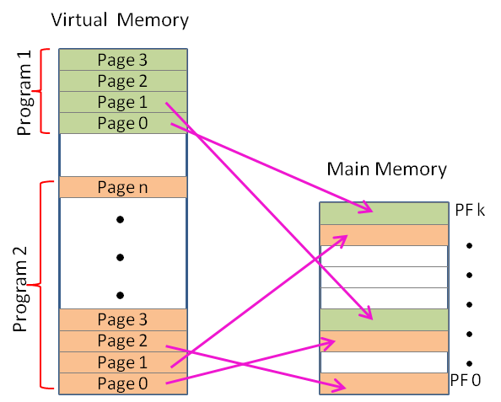
Memory management
Virtual Memory uses secondary storage to give programs the illusion that they have infinite storage
We split the process into smaller, fixed-size, pages. Load pages into memory only when needed
A process in memory is not contiguous

Slide 104

Memory management
Virtual Memory uses secondary storage to give programs the illusion that they have infinite storage
Virtual addresses!
Physical addresses!
We split the process into smaller, fixed-size, pages. Load pages into memory only when needed
A process in memory is not contiguous
In probe.c, we are seeing virtual addresses!
Internal fragmentation vs external fragmentation

Slide 105
OS Review
Process Manager
Manages how processes are structured and how to handle many processes running at once
Interface Manager
Manages communication between apps and hardware
Memory Manager
Manages how physical memory is utilized

Slide 106


Illusion Manager
Gives applications the illusion that they have infinite storage and resources
Traffic Manager
Manages which programs should be executed by the CPU
“Unlimited RAM”
Process A
(Ready)
Process B
(Urgent)
CPU
Process C
(Ready)
HDD
Virtual Memory
Process D
(Blocked)

Slide 107
The jobs of an Operating System
1. Process Manager
2. Interface Manager
3. Memory Manager
4. Traffic Manager
5. Illusion Manager
“The Coach”
“The Bouncer”
“The Farmer”
“The Judge”
“The Illusionist”

